Slide 1

Quantum Communications Group
Weekly Report
Supervisors:
Armando Nolasco Pinto
anp@ua.pt
Diogo Matos
dftm@ua.pt

Slide 2
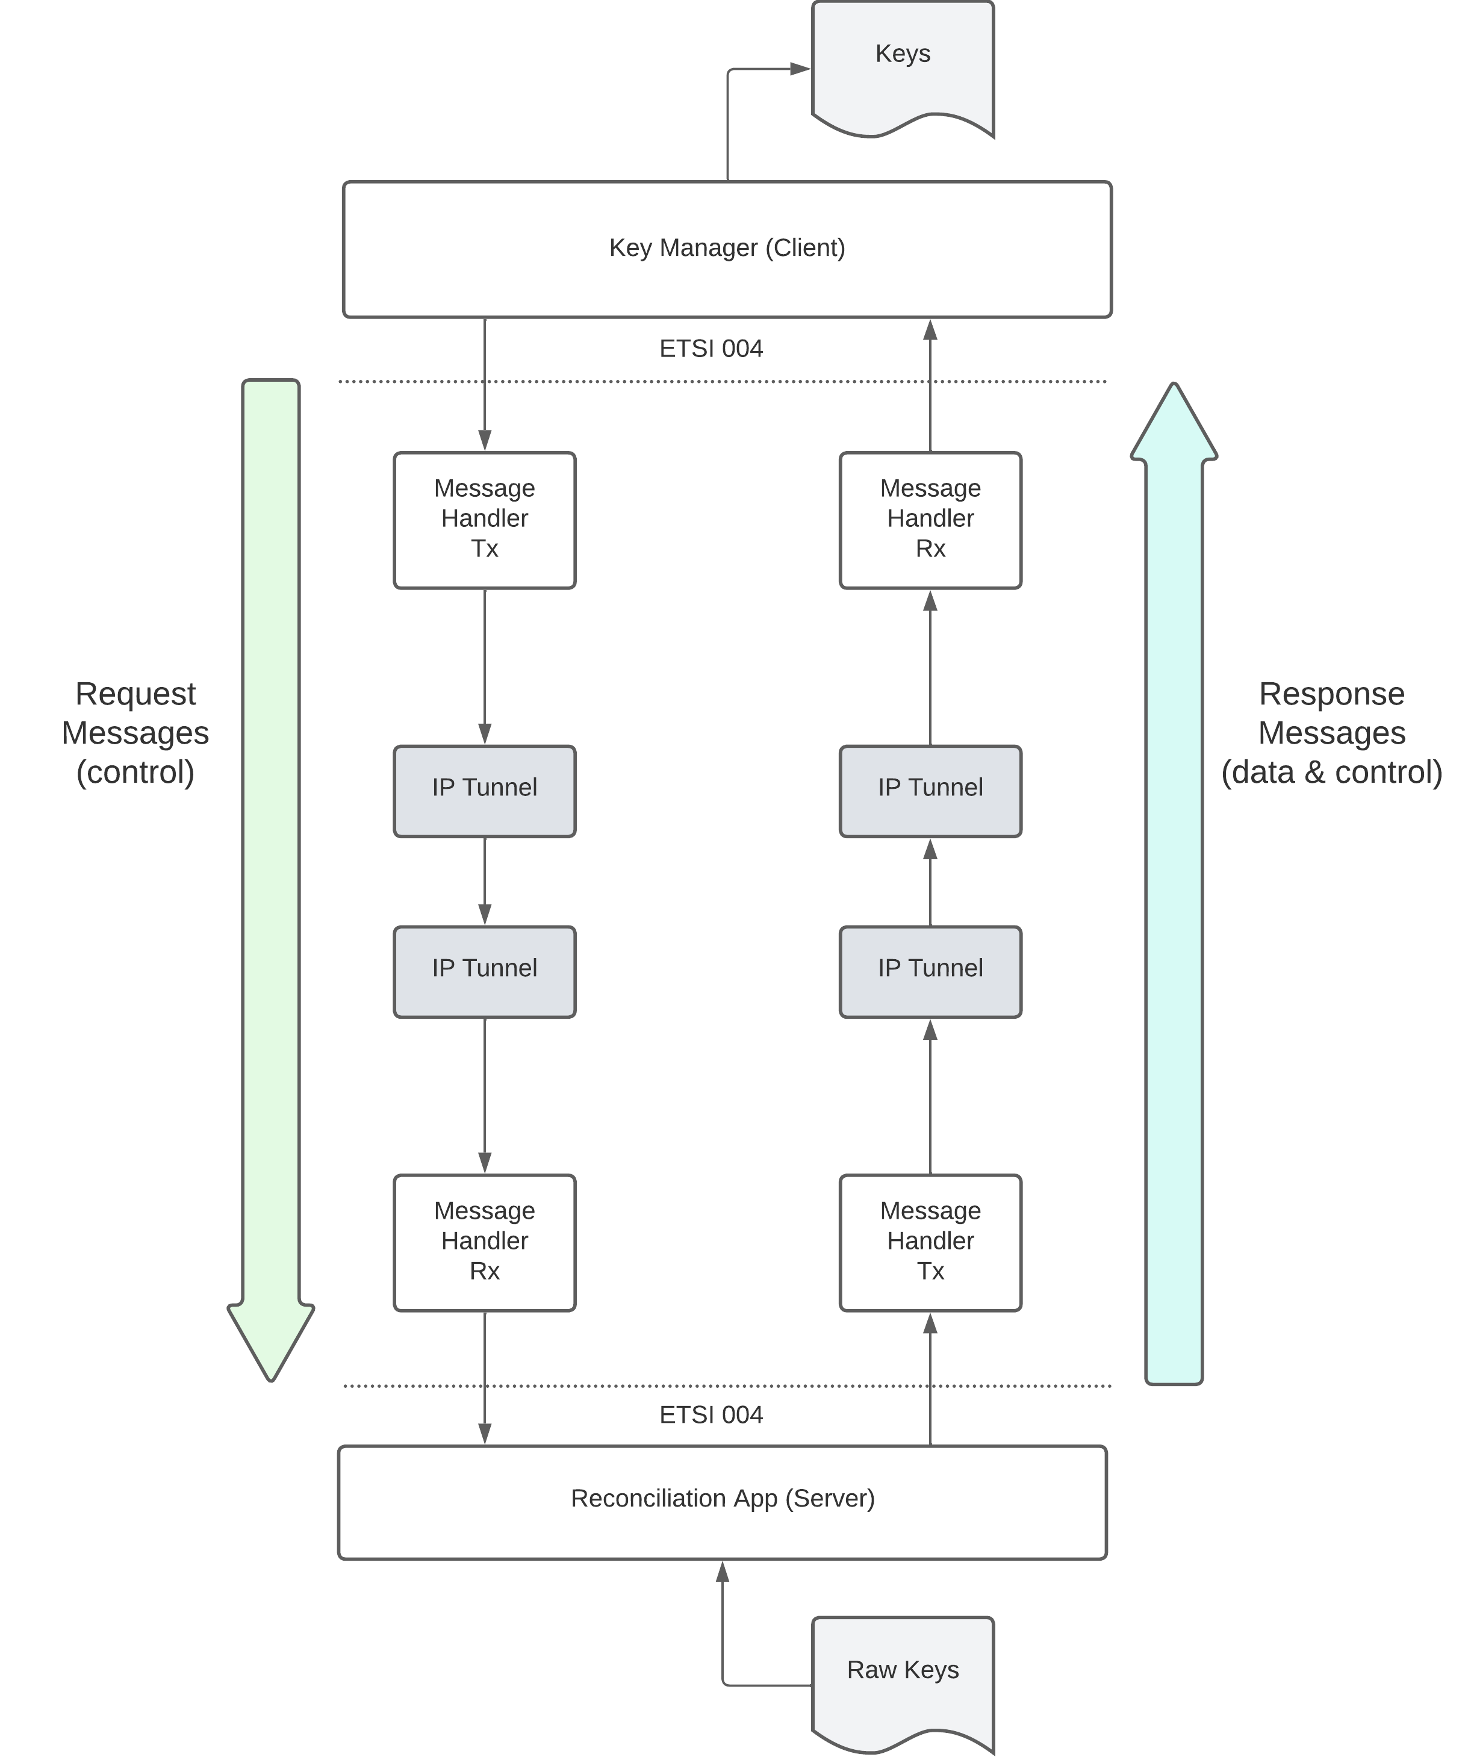
Diagram for the South interface
The interface between the Key Manager and the Reconciliation App is based on ETSI QKD 004 in push mode (the KMS is always receiving keys without making individual requests for each one).
The KMS will start by making an OPEN_CONNECT request to create a connection to the Reconciliation App. Then does one GET_KEY request and from that moment forward it will receive key material with the characteristics and pace specified in the QoS field until it makes a CLOSE request to terminate the key stream.

Slide 3
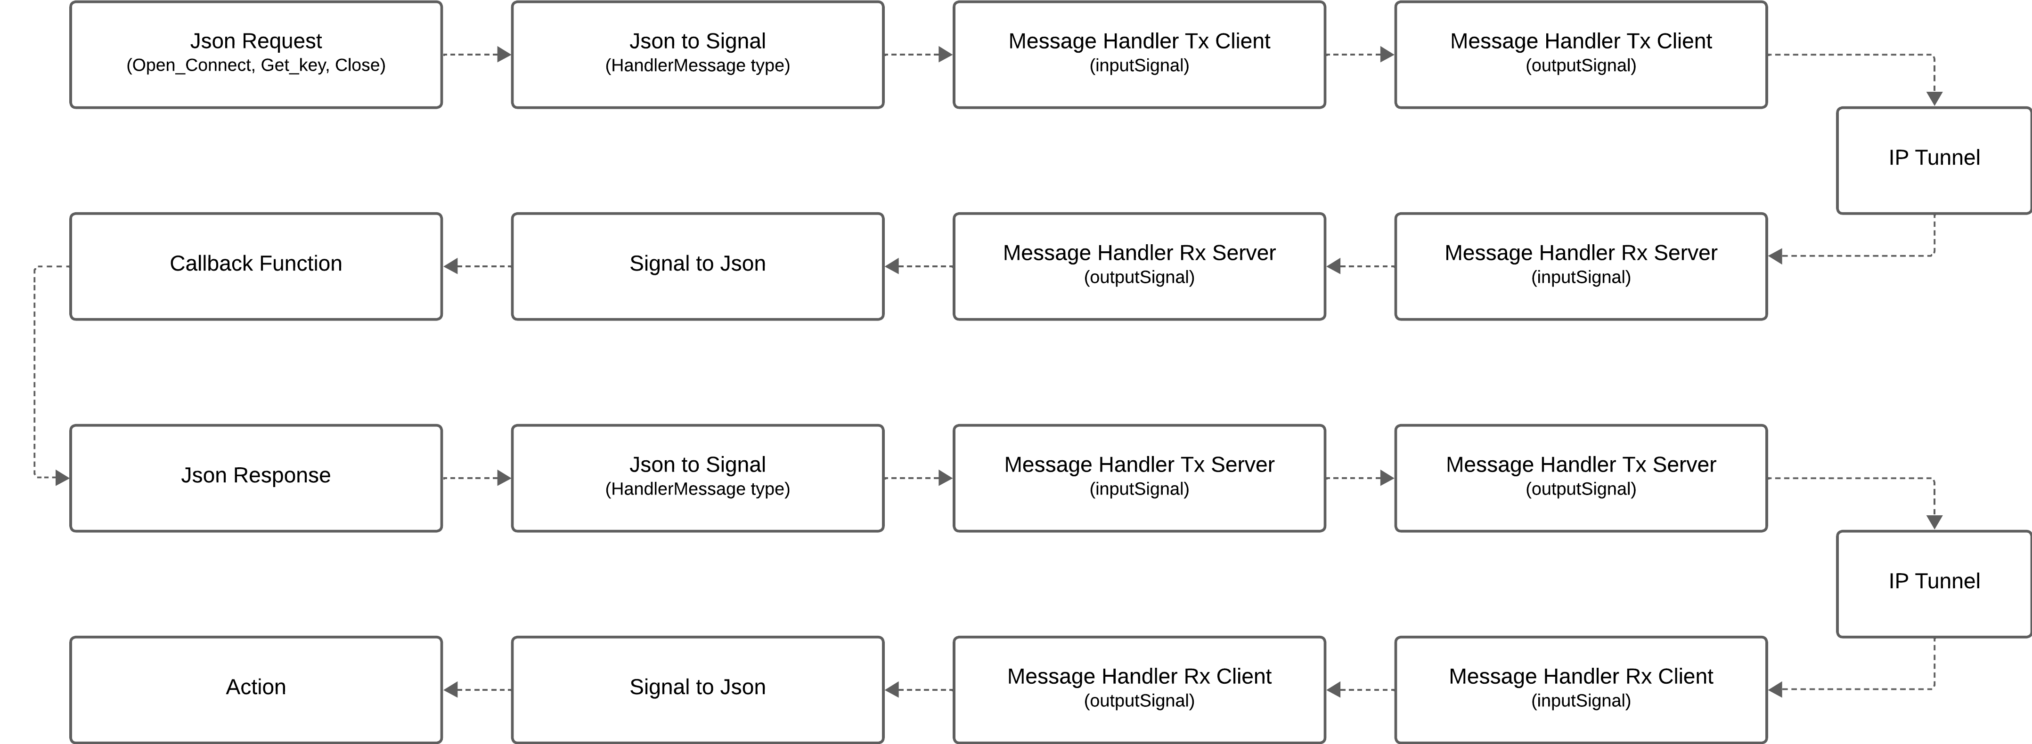
South Interface Flow

Slide 4
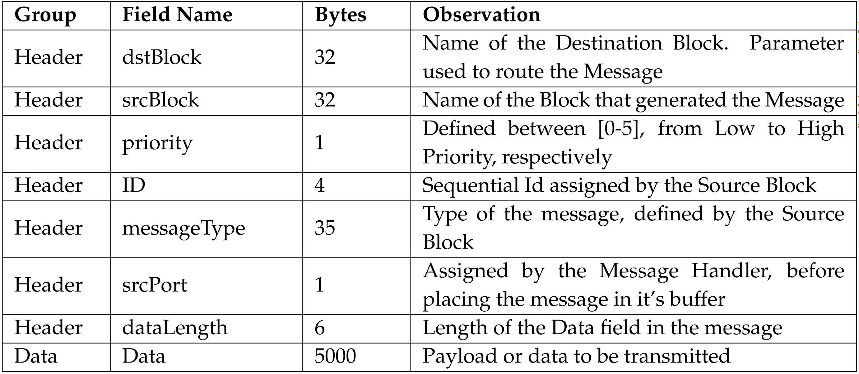
HandlerMessage Signal
The HandlerMessage Signal is an type of Input signal defined in the class t_handler_message. This class resides in the NetXpto module and was created to replace the previous t_message class. This new class implements more macros, abilities with operator functions and more information about the message encoded in the header. The new Message Format is defined in the forward Table.
There are also macros indicating the sizes, in bytes, present in the table.

Slide 5
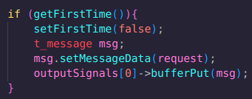
Block load_request.cpp
This block is used to load a request to the buffer. Its Output Signal is of the type Message, which will be the Input Signal of the Message Handler and will then be converted to the HandlerMessage type, inside the Message Handler.
The data field is our request. There is no need to fill the headers, since it will be converted next to HandlerMessage (t_handler_message class).
(DstBlock) Msg_Rx || (srcBlock) Msg_Tx || (priority) 5 || (ID) 0 || (Type) Message || (srcPort) 0 || (Datalength) 280 || (Data) {"command":"OPEN_CONNECT","data":{"source":"source","destination":"destination","qos":{"key_chunk_size":3,"max_bps":5,"min_bps":1,"jitter":4,"priority":5,"timeout":0,"ttl":10,"metadata_mimetype":"metadata"},"key_stream_id":"key_stream_id"}

Slide 6
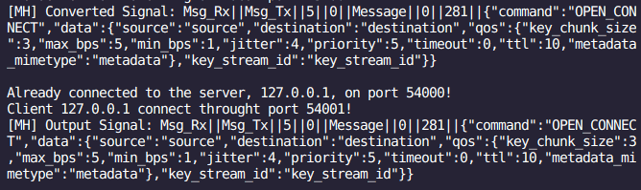
Message Handler Tx (KMS)

Slide 7
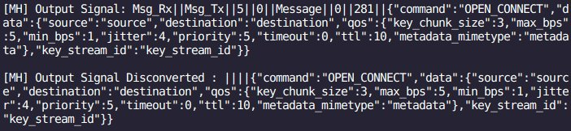
Message Handler Rx (App_Server)

Slide 8
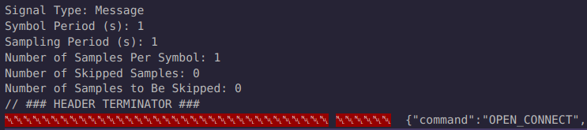
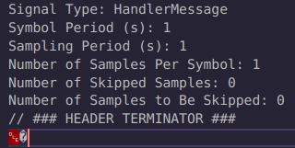
Input and Output Signals

Slide 9
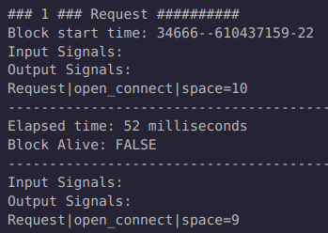
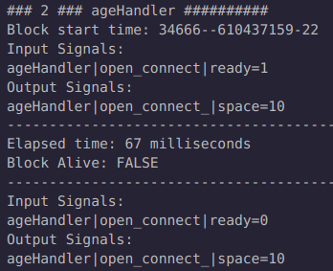
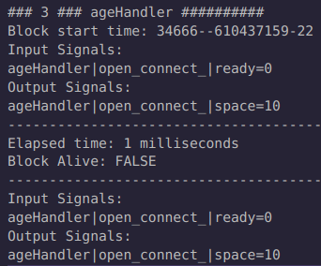
Log file

